Slide 1
Machine Learning Techniques

Slide 2
Machine Learning Techniques
ML Techniques
Regularization
Bagging and Boosting
Cross Validation

Slide 3
Ensemble Techniques : Bagging and Boosting
Bagging and Boosting are both ensemble learning techniques used to improve model performance by combining multiple models. The main difference is that:
Bagging reduces variance by training models independently.
Boosting reduces bias by training models sequentially, focusing on previous errors.

Slide 4
Ensemble Techniques : Bagging
Bagging (Bootstrap Aggregating) aims to reduce model variance by training multiple models on different random subsets of the dataset. These subsets are created using bootstrapping, where data points are sampled with replacement.
Each model is trained independently, and their predictions are combined using voting for classification or averaging for regression. As models are trained independently, Bagging works well with high-variance models like decision trees.

Slide 5
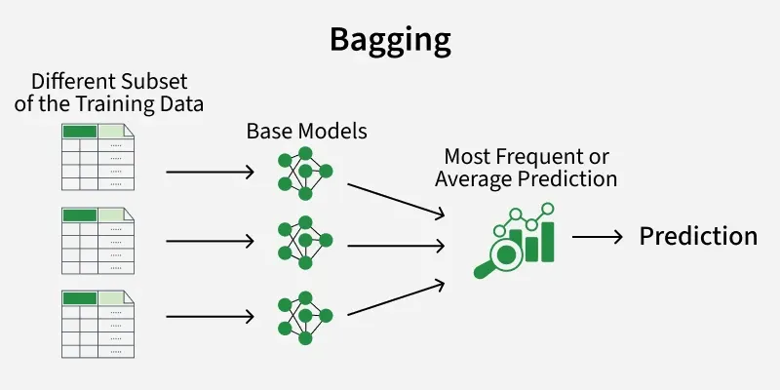
Ensemble Techniques : Bagging

Slide 6
Ensemble Techniques : Boosting
Boosting focuses on improving model accuracy by training models sequentially. Each new model pays more attention to the data points that were misclassified by previous models. Over time, the ensemble becomes better at handling difficult cases.
Boosting is effective for reducing bias and works well even with weak learners.

Slide 7
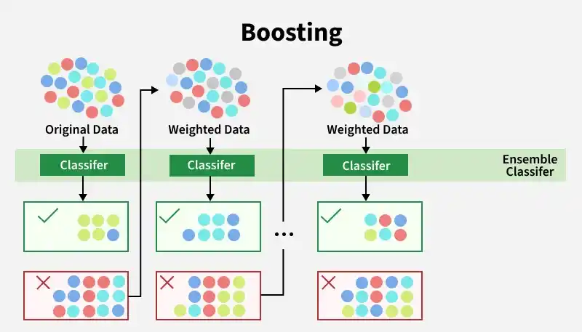
Ensemble Techniques : Boosting

Slide 8
Bagging vs Boosting
Feature | Bagging | Boosting
Training style | Trains Independent models | Trains sequential models
Main goal | Reduce variance | Reduce bias
Handling errors | All samples treated equally | Focuses on misclassified samples
Overfitting | It is less sesitive to overfitting | More prone to overfitting
Parallel training | Yes it supports parallel computing | No it does not supports parallel computing
Sensitivity to noise | It is not affected by noise and outliers | Sensitive to noise and outliers

Slide 9
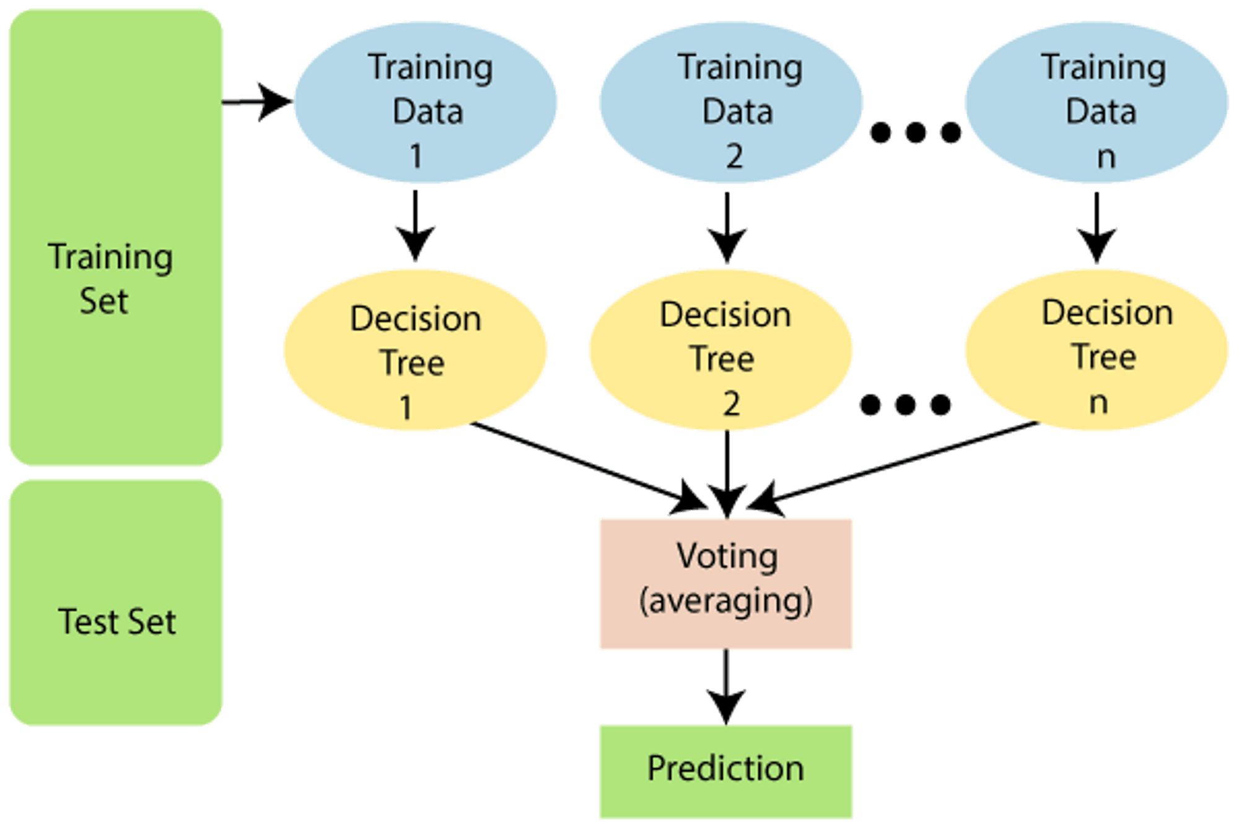
Random Forest

Slide 10
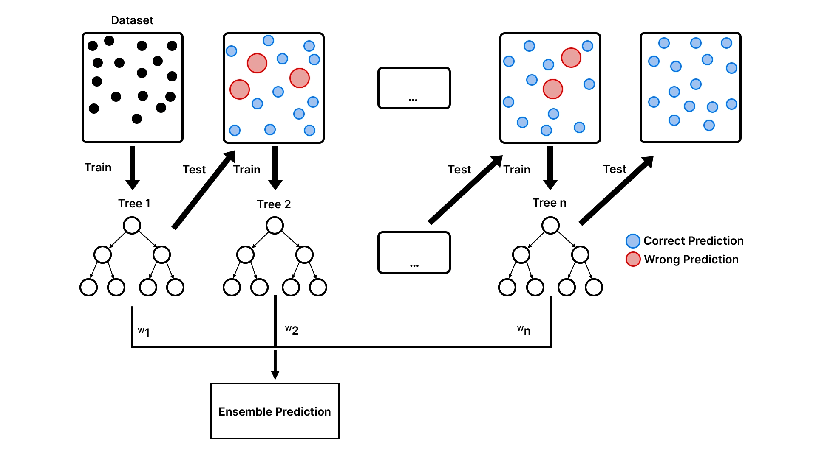
XGboost (support missing values and handle overfitting)

Slide 11
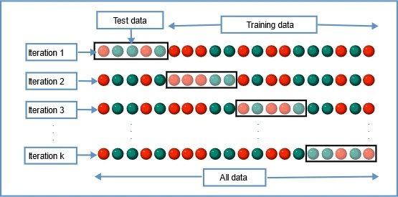
Cross Validation
Cross-validation is a technique used to check how well a machine learning model performs on unseen data while preventing overfitting. It works by:
Splitting the dataset into several parts.
Training the model on some parts and testing it on the remaining part.
Repeating this resampling process multiple times by choosing different parts of the dataset.

Slide 12
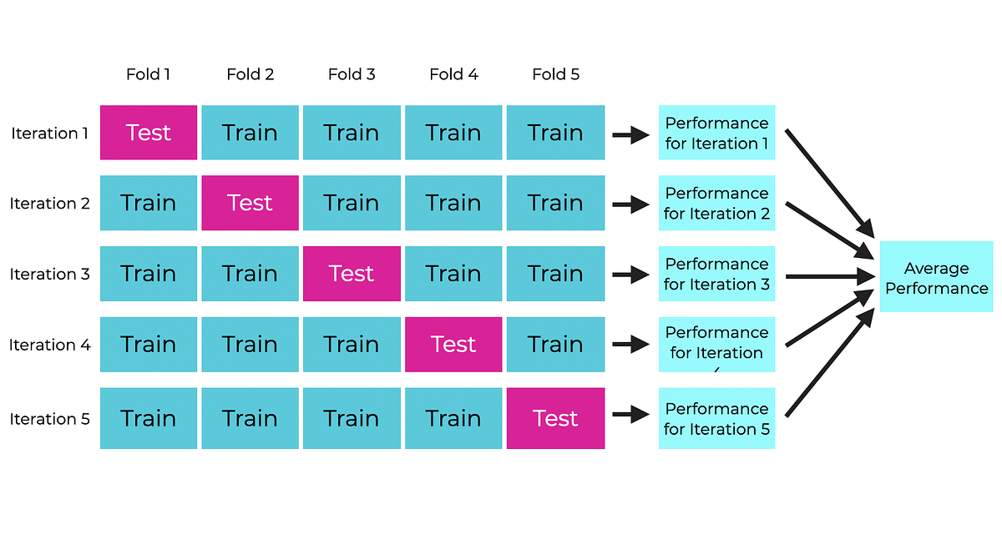
Types of Cross Validation
K-Fold
K-Fold Cross Validation splits the dataset into k equal-sized folds. The model is trained on k-1 folds and tested on the remaining fold. This process is repeated k times each time using a different fold for testing.
Disadvantages:
Low accuracy in case unbalanced data.

Slide 13
Types of Cross Validation
Stratified K Fold Cross Validation
Stratified K-Fold Cross Validation is a technique used for evaluating a model. It is particularly useful for classification problems in which the class labels are not evenly distributed i.e data is imbalanced. It is a enhanced version K Fold. Key difference is that it uses stratification which allows original distribution of each class to be maintained across each fold.

Slide 14
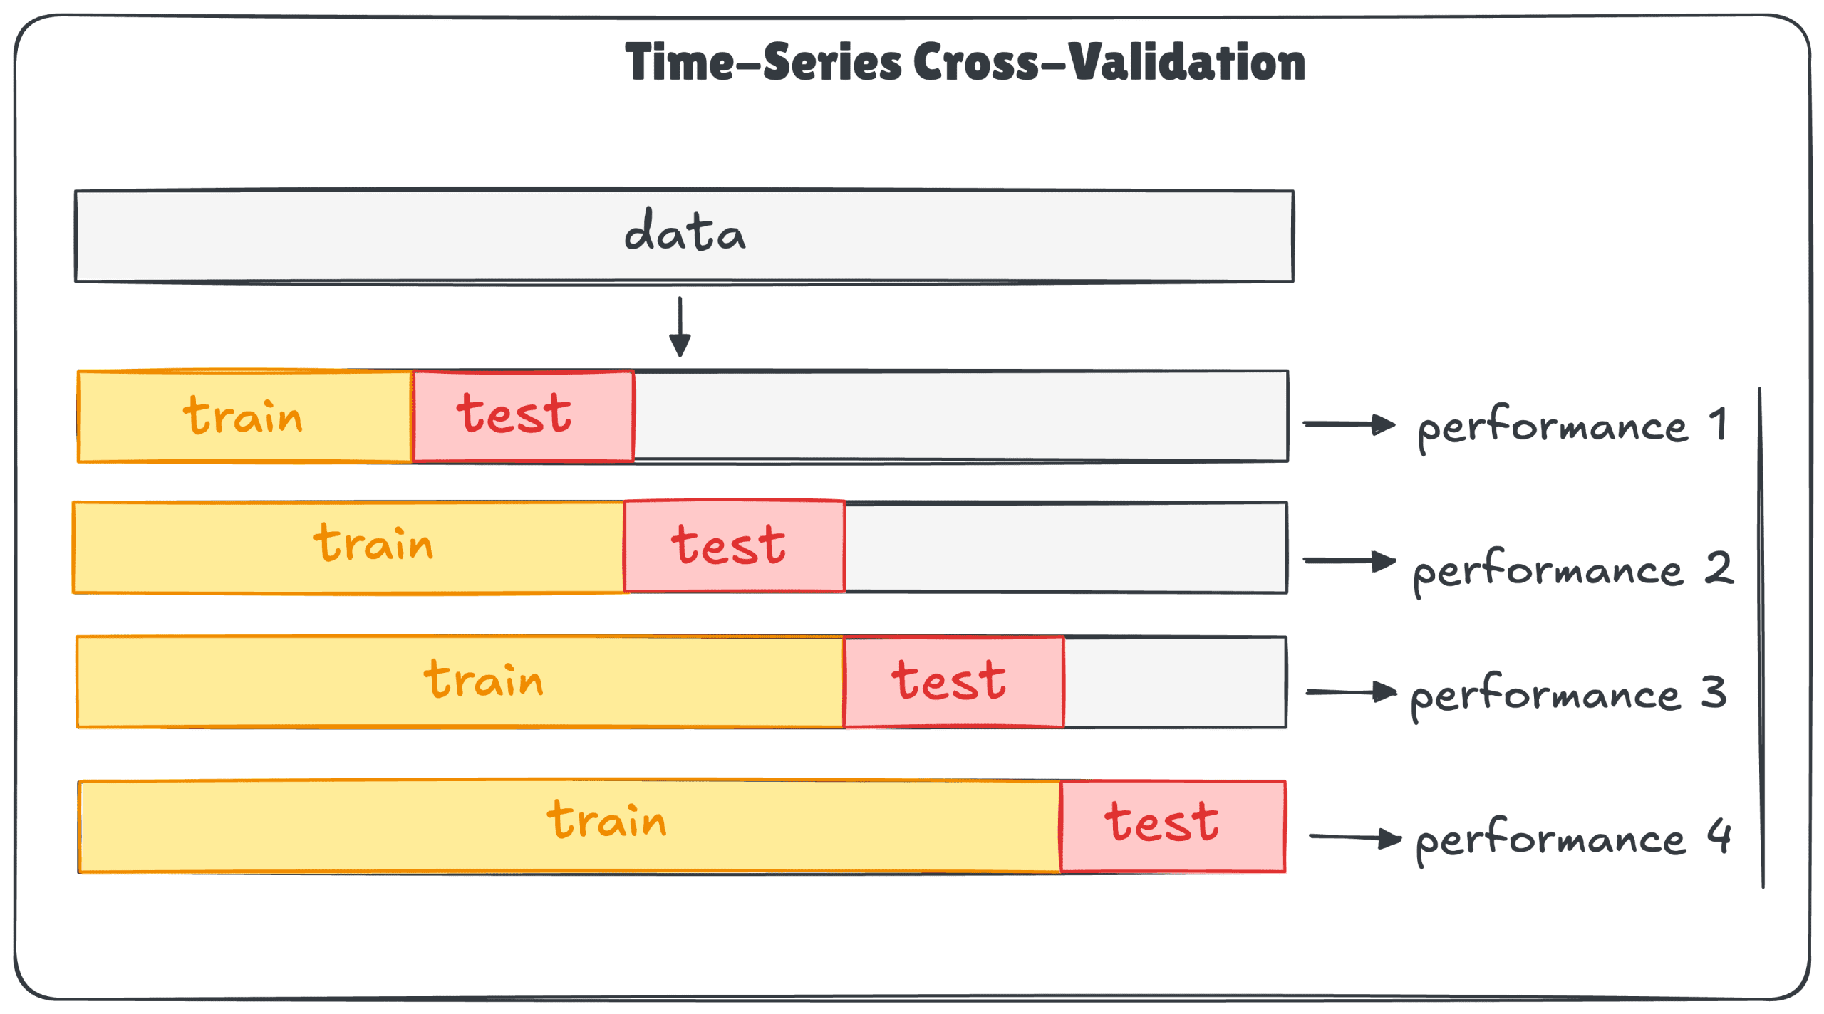
Types of Cross Validation
Time Series Cross Validation
Time Series Cross-Validation extends traditional cross-validation techniques to handle the temporal structure inherent in time series data. It ensures that the model is evaluated on past data and tested on future data, mimicking real-world scenarios.

